Slide 1

Brogrammers
Wireless Access Point Intrusions

Slide 2
Table of Contents
Introduction
Problem Statement
Examples
Demo

Slide 3


Bangladeshi Bank Heist
In May of 2015 four men walked into an RCBC bank in the Philippines.
Seemingly abandoned newly created bank accounts with $500 each
Malicious email was sent to an employee at the bank in Bangladesh
Malware allowed culprits to gain access to inner workings of the bank
Hackers spent time studying the habits of the bank

Slide 4


The hackers were able to receive SWIFT credentials
Using these credentials they were able to process 35 fraudulent transfer requests totalling 951 million dollars
Due to fortunate circumstances 30 out of 35 requests were flagged since the names on the orders matched that of a shipping company blacklisted by the U.S. government

Slide 5

Other factors such as the size of the remaining transactions as well as trivial mistakes like the spelling of the word “foundation” raised suspicions.
This caused more money to be retracted...leaving the hackers with roughly 80,000,000.
FBI cyber investigators later concluded that North Korea was behind the attack

Slide 6
Shamoon Malware Attack
Conducted by group named “A Cutting Sword of Justice”:
Wireless intrusion attack in August 2012
Attacked Saudi Aramco, Saudi Arabia’s national oil firm
Motivation: “Fed up with atrocities and crimes taking place around the world.”
Targeted the Al-Saud regime for their support of this oppression
Attack Execution:
Entry based on Aramco’s WiFi vulnerability
Spread Malware through the local area connection, >30,000 workstations infected
Three part malware (Dropper, Wiper, Reporter)

Slide 7
Shamoon Malware Attack
Attack Structure:
Dropper placed the other two malware portions on the computer, populated itself through the network, and self-executed as a service on Windows boot
Wiper deleted files, replaced with corrupted JPEG images, gathered file information for the attacker
Reporter performed reconnaissance, sent information gathered by Wiper back to attacker
Damage and Aftermath:
Infected workstations were rendered useless, had to be replaced
To prevent further spreading, Aramco disconnected all systems and data centers
Aramco restarted operations on August 25th, however Attacker leaked sensitive information about the CEO, information of Aramco’s wireless network, and Aramco’s security appliances on the 27th.

Slide 8
Security Breach
In both of these incidents, a local network was breached and access was gained to all computers on the network.
Gaining access to a secure network can be nearly as harmful as gaining physical access to a machine since most security precautions and protections are aimed at preventing outside intrusions into the network.
However, if those protections can be bypassed by simply breaking into the network itself, then those security safeguards are made useless.

Slide 9
How WEP Wireless Cracking Works
Requires WEP protected network
Use USB wifi adapter in monitor mode using Airmon-ng
Target wireless network
Start packet sniffing (monitoring)
Wait until enough packets have been intercepted to decrypt
Or use Air-replay to flood network with packets
Once you’ve collected enough packets, use Aircrack-ng to

Slide 10
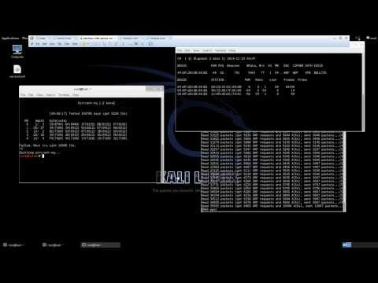
Demo

